Slide 1
Classic Paper Notes

Slide 2
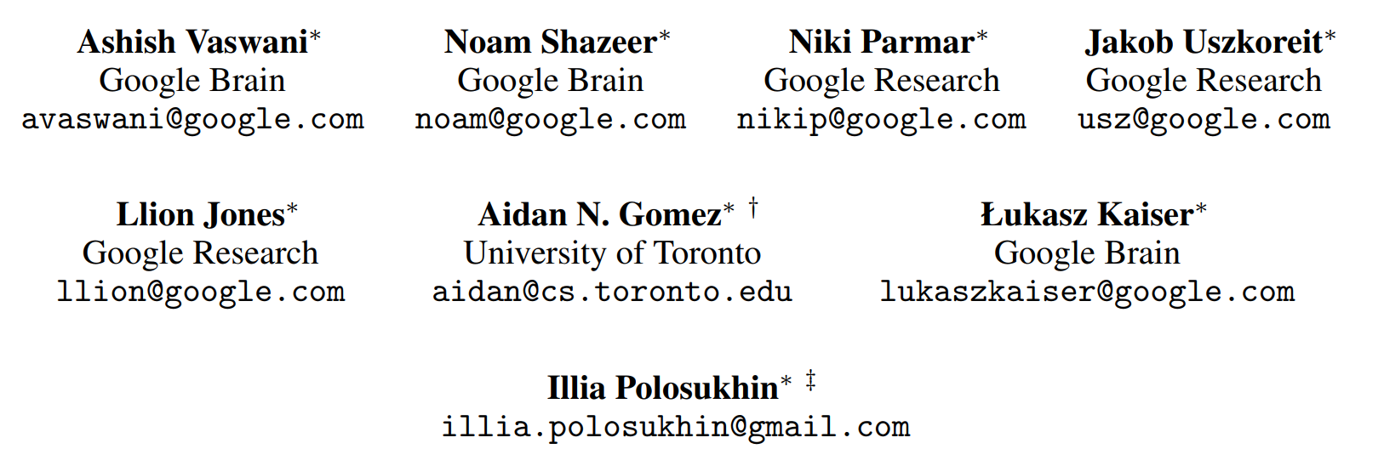
Attention Is All You Need
06/2017
Cited by: 29k

Slide 3
Sequence Transduction
Like machine translation tasks, from a sequence to another sequence.
Encoder-decoder structure. At each step the model is auto-regressive (pass output as current input).
Transformer
a simple network architecture, solely on attention mechanisms, without RNN or CNN.
Trains faster and Generalizes well on other tasks.

Slide 4
RNN
Generate a sequence of hidden states, h_{t} , as a function of the previous hidden state h_{t-1} and intput for position t. This mechanism guarantees the combination of current and history information.
Drawbacks:
Sequence computation remains, cannot be parallel.
Cannot modeling long-time mutual information, memory overhead.

Slide 5
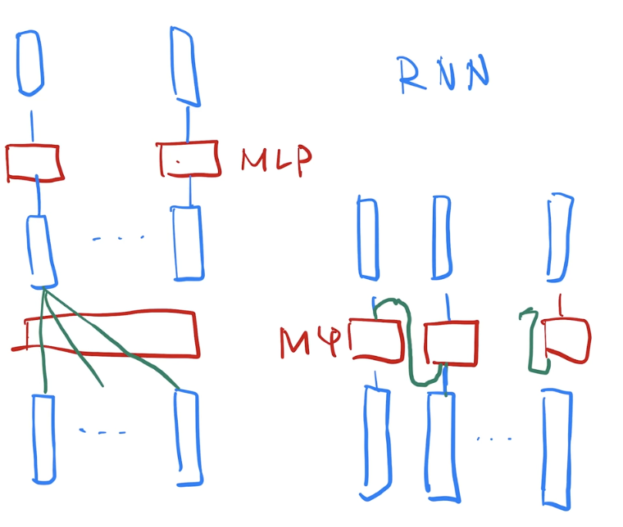
Transformer v.s. RNN
Different in information transferring

Slide 6
Transformer v.s. CNN
Transformer uses attention algorithm, can view all the elements, while CNN view limited elements (like 3x3).
Transformer uses multi-head attention to imitate multi-channel in CNN.
Self-attention.

Slide 7
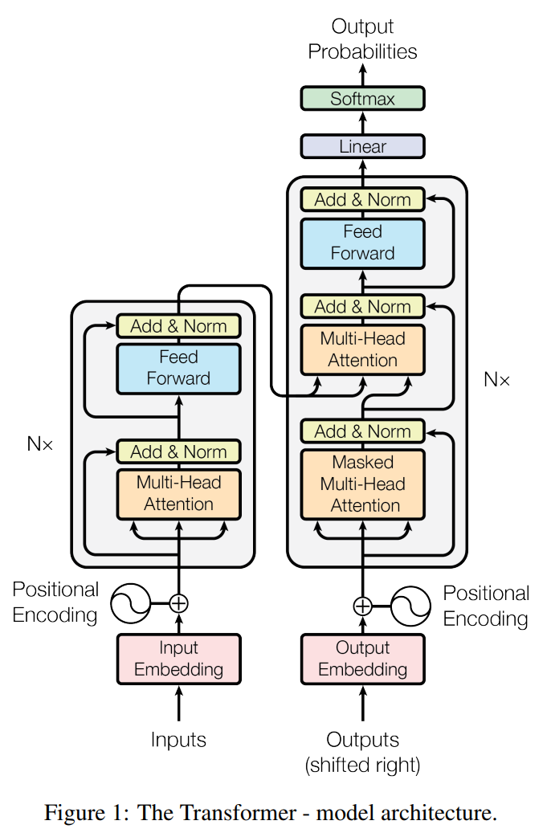
Transformer
Embedding & Positional Encoding
Residual connection

Slide 8
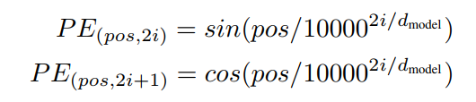
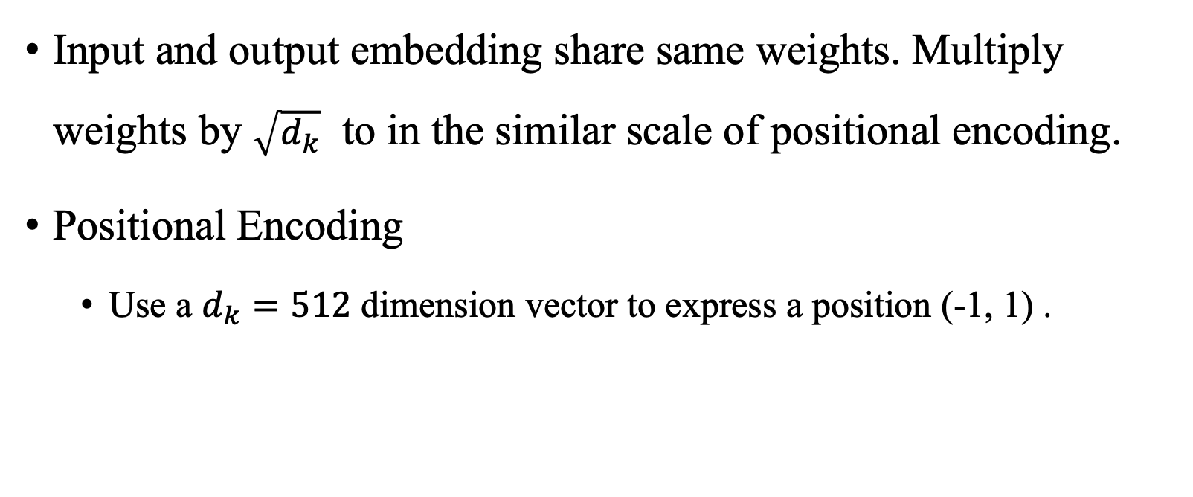
Transformer
Input and output embedding share same weights. Multiply weights by $\sqrt{d_{k}}$ to in the similar scale of positional encoding.
Positional Encoding
Use a $d_{k}=512$ dimension vector to express a position (-1, 1) .

Slide 9
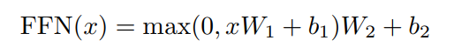
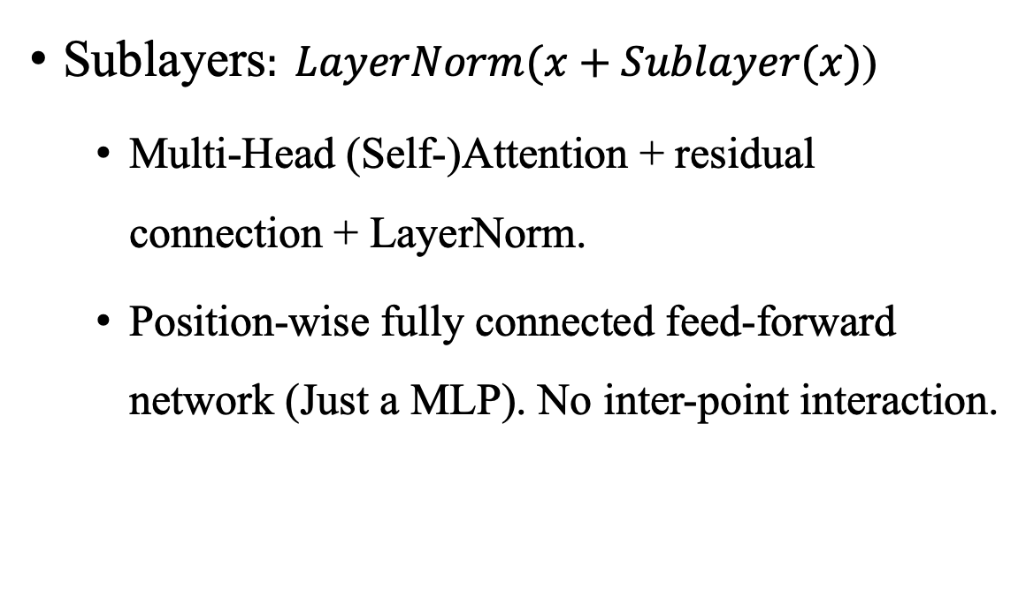
Transformer (Encoder)
Input_d = 512
Sublayers$: LayerNorm(x+Sublayer(x)$)
Multi-Head (Self-)Attention + residual connection + LayerNorm.
Position-wise fully connected feed-forward network (Just a MLP). No inter-point interaction.
Output_d= 512

Slide 10
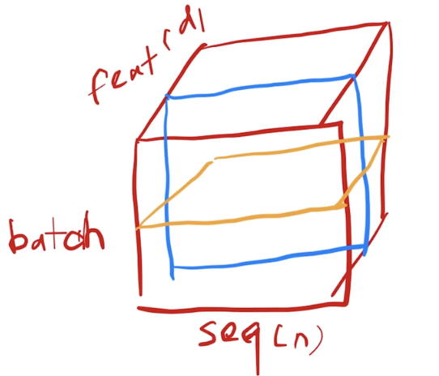
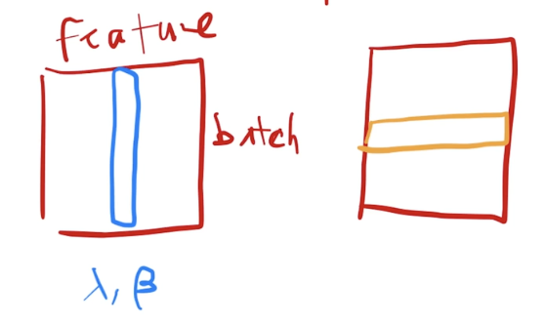
LayerNorm?
BatchNorm: norm on the batch dimension.
Every feature, Select all samples in a batch
LayerNorm: norm on the feature dimension.
Every sample, select all features of it.

Slide 11
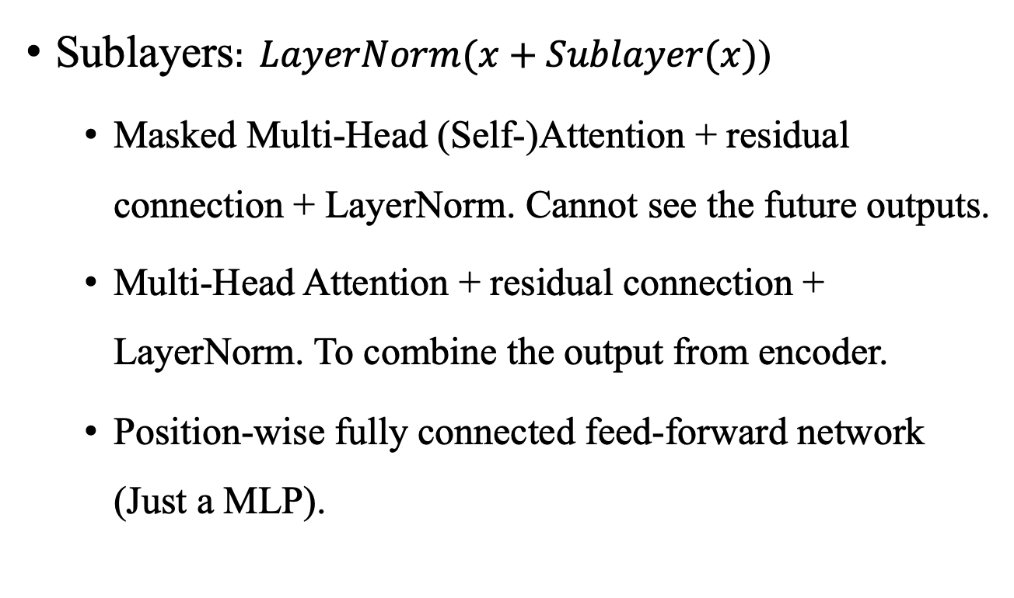
Transformer (Decoder)
Sublayers$: LayerNorm(x+Sublayer(x)$)
Masked Multi-Head (Self-)Attention + residual connection + LayerNorm. Cannot see the future outputs.
Multi-Head Attention + residual connection + LayerNorm. To combine the output from encoder.
Position-wise fully connected feed-forward network (Just a MLP).

Slide 12
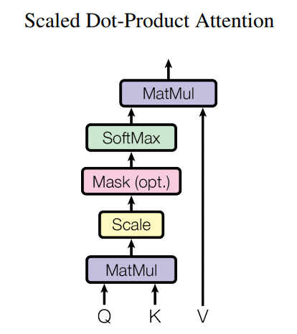
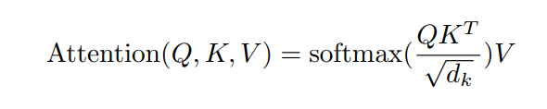
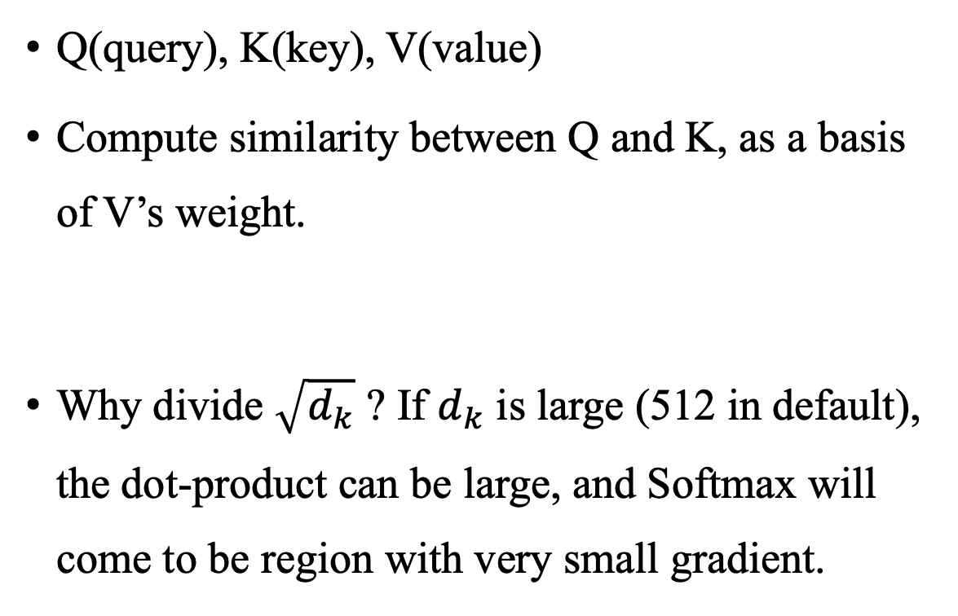
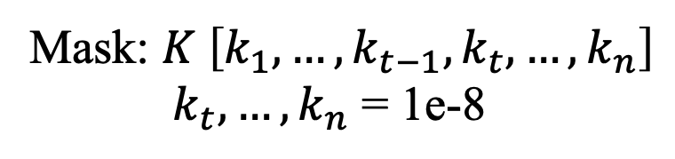
Attention?
Mask: $K \left[k_{1}, …,k_{t−1},k_{t}, …,k_{n}\right]$
$k_{t}, …,k_{n}$ = 1e-8
Q(query), K(key), V(value)
Compute similarity between Q and K, as a basis of V’s weight.
Why divide $\sqrt{d_{k}}$ ? If $d_{k}$ is large (512 in default), the dot-product can be large, and Softmax will come to be region with very small gradient.

Slide 13
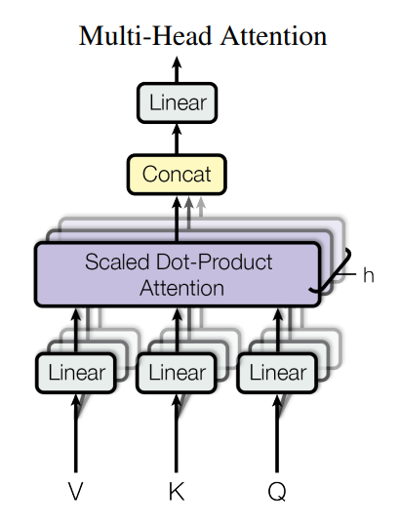
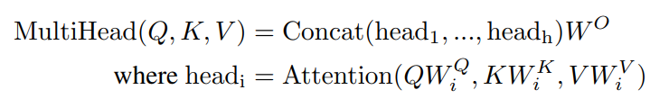
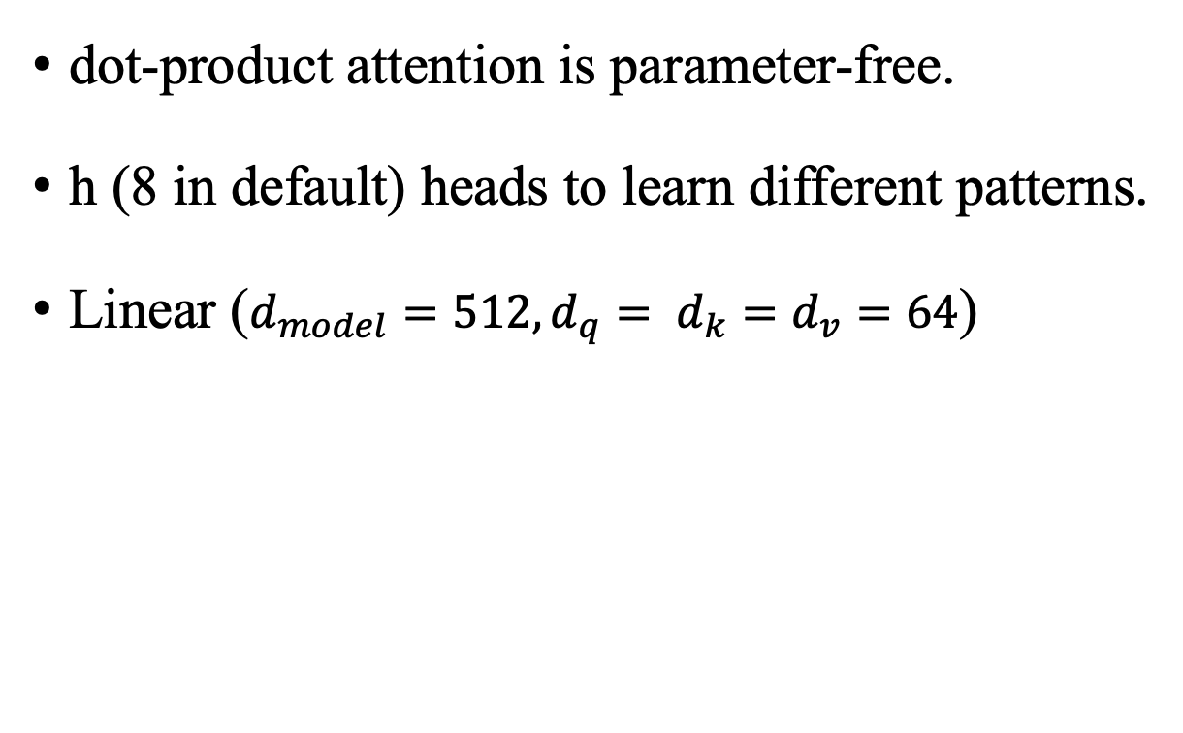
Multi-Head Attention
dot-product attention is parameter-free.
h (8 in default) heads to learn different patterns.
Linear ($d_{model}=512, {d_{q}= d}_{k}=d_{v}=64$)

Slide 14
Transformer
K, V from Encoder (input)
Q from Decoder (output)
Allow information transferring from Encoder to Decoder

Slide 15
Regularization
Residual dropout
Apply dropout to the output of each sub-layer
Dropout rate = 0.1
Label smoothing
label smoothing of value = 0.1, quite small
Hurts perplexity, but improve accuracy and BLEU

Slide 16
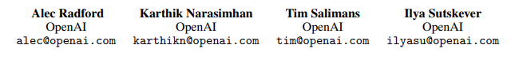
Improving Language Understanding by Generative Pre-Training
06/2018
Cited by: 3k

Slide 17
GPT (Generative Pre-Training)
Natural language understanding tasks.
Generative pre-training of a language model on unlabeled data – Discriminative fine-tuning on specific tasks.
Based on Transformer. Author believes that Transformer learns long-term structure than RNN.
BERT is cloze task, GPT is future prediction task.

Slide 18
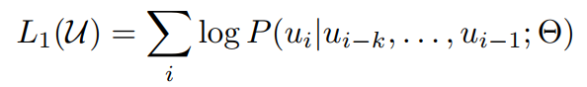
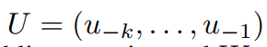
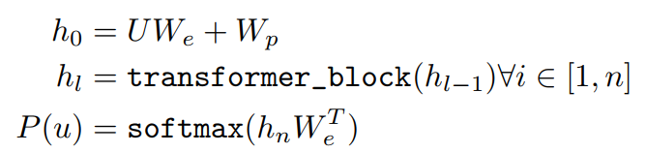
Pre-training
Next word prediction with k context window. Maximize the likelihood.
Use multi-layer Transformer decoder (there is a mask MSA).

Slide 19
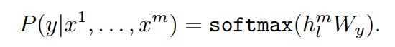
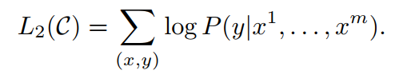
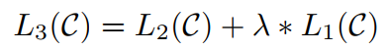
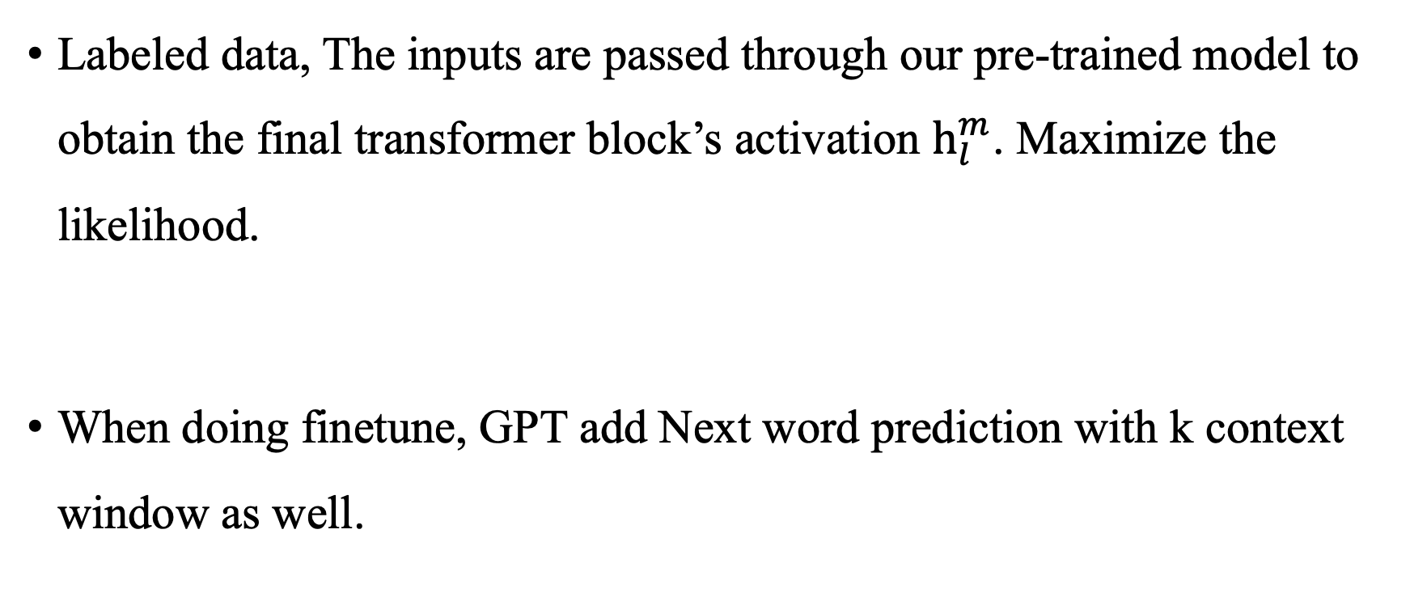
Finetuning
Labeled data, The inputs are passed through our pre-trained model to obtain the final transformer block’s activation $h_{l}^{m}$. Maximize the likelihood.
When doing finetune, GPT add Next word prediction with k context window as well.

Slide 20
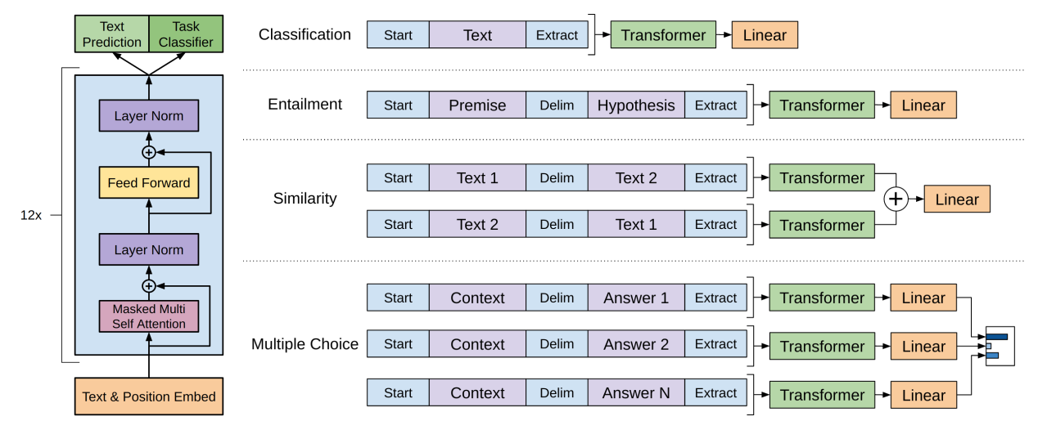
Applications

Slide 21
Language Models are Unsupervised Multitask Learners
02/2019
Cited by: 5k

Slide 22
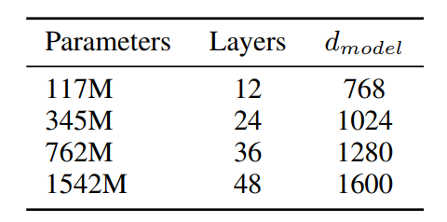
GPT-2?
New dataset WebText. Larger, 127,000+ training examples.
Larger model, GPT-2, 1.5B parameter Transformer.
While not very advantageous than BERT.
New story: good at zero-shot! No labels needed even in finetuning.
VIT-B
VIT-L

Slide 23
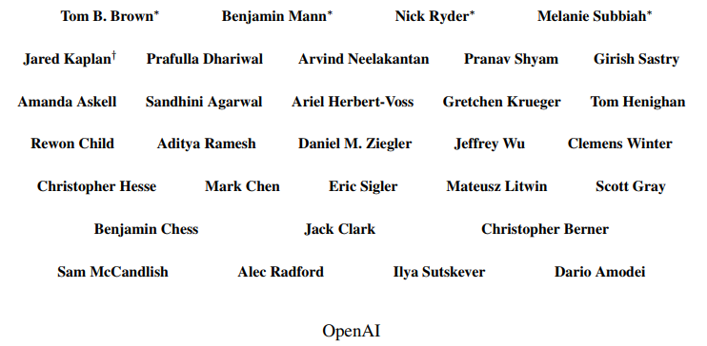
Language Models are Few-Shot Learners
05/2020
Cited by: 3k

Slide 24
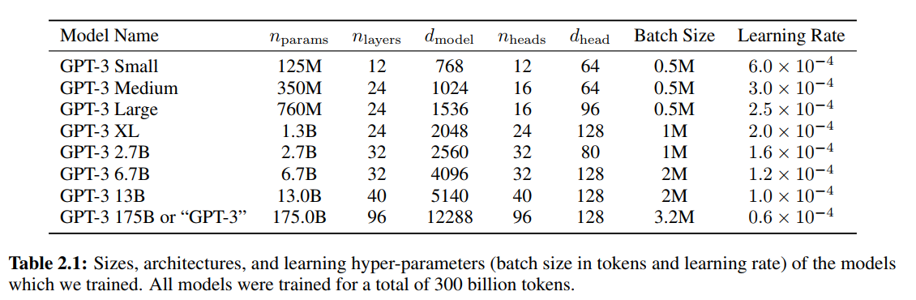
GPT-3? Few-Shot/One-Shot
Many experiments.
175B parameters model.
Without any gradient updates or finetuning.
Generate samples of news articles which is hard to tell if it is generated by AI or written by humans.

Slide 25
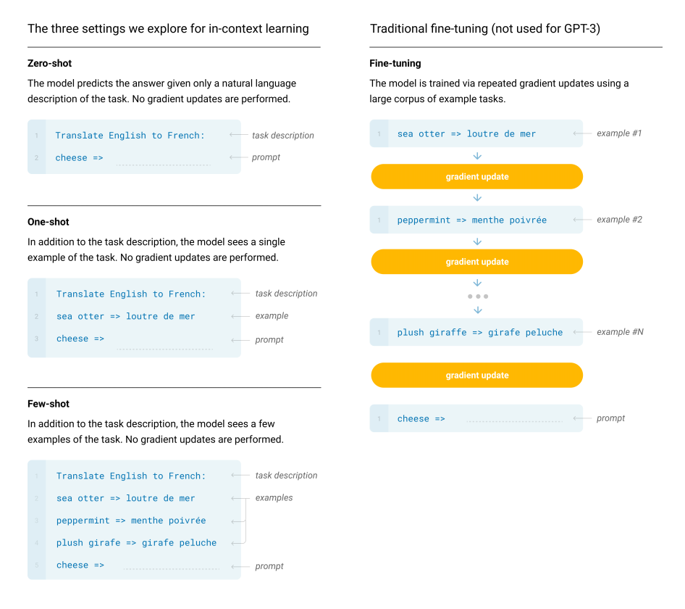
Zero-Shot/Few-Shot/one-shot

Slide 26
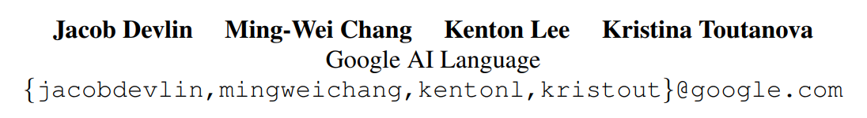
BERT: Pre-training of Deep Bidirectional Transformers for Language Understanding
10/2018
Cited by: 27k

Slide 27
Bidirectional Encoder Representations from Transformer
Like in CV field, Bert managed to enable a deep pretrained model to be universally valid in all NLP tasks. (combine GPT and ELMo)
Unlike GPT, Bert use bidirectional pre-training schedule.
Unlike ELMo, Bert is task-agnostic and just need to finetune the output layer, and Bert use Transformer rather than RNN.
Conceptually simple and empirically powerful.

Slide 28
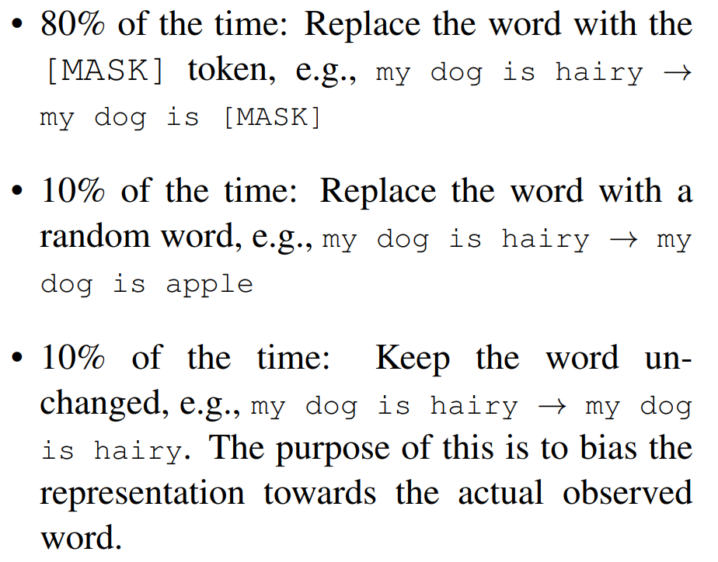
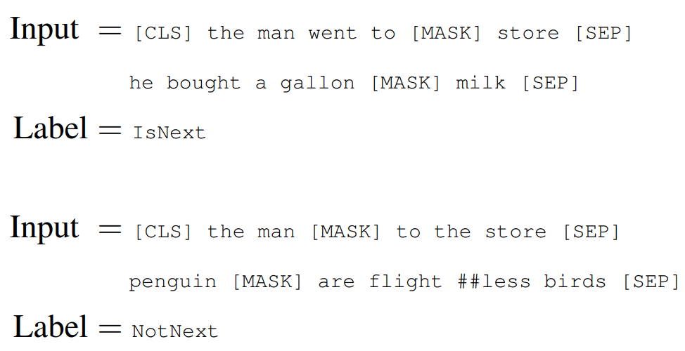
BERT tasks (Unsupervised data)
Masked Language model (MLM)
Mask some tokens (15% become [MASK]) from the input randomly and predict the original vocabulary ids of the masked tokens (cloze task) bidirectionally.
Next sentence prediction (NSP)
Two sentence (50%) and judge whether they are adjacent. To learn the sematic meaning of sentence.

Slide 29
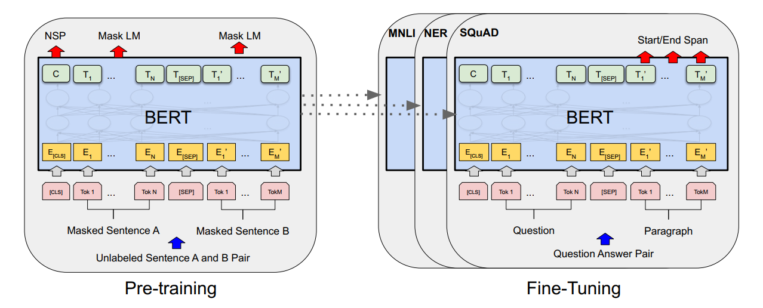
Model Architecture
Origin Transformer Framework

Slide 30
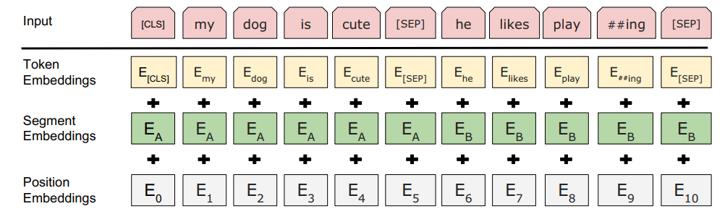
Pretrain
Input
A single sentence or a pair of sentences like <Question, answer>
WordPiece embedding
[CLS] for aggregation, [SEP]/embedding for separate element in pair.
Output
Different output layer on features
to do NSP and MLM .

Slide 31
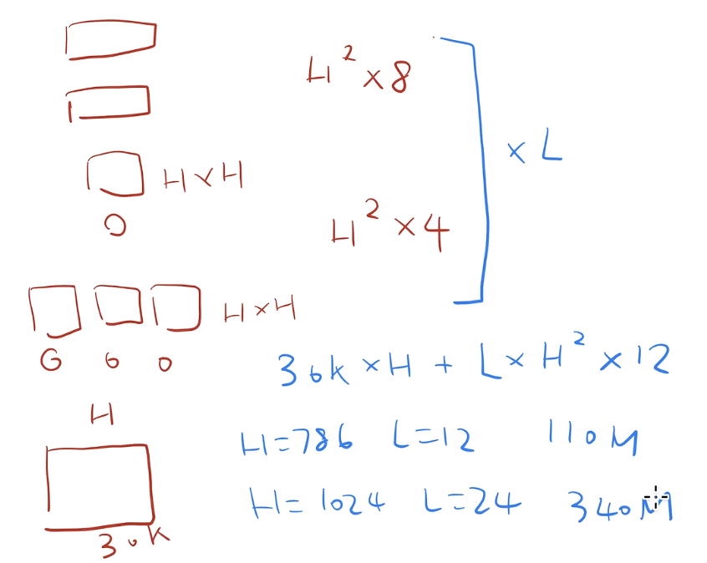
Parameter Estimation
30k: the size of dictionary;
H: hidden size; L: layer number

Slide 32
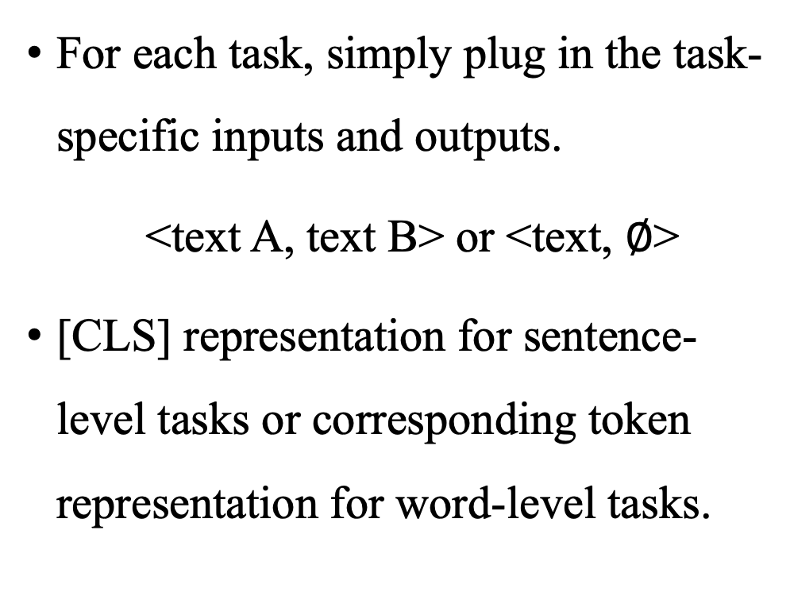
Finetune
For each task, simply plug in the task-specific inputs and outputs.
<text A, text B> or <text, $∅$>
[CLS] representation for sentence-level tasks or corresponding token representation for word-level tasks.

Slide 33
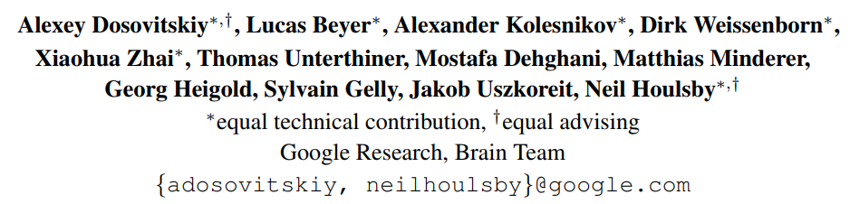
AN IMAGE IS WORTH 16X16 WORDS: TRANSFORMERS FOR IMAGE RECOGNITION AT SCALE

Slide 34
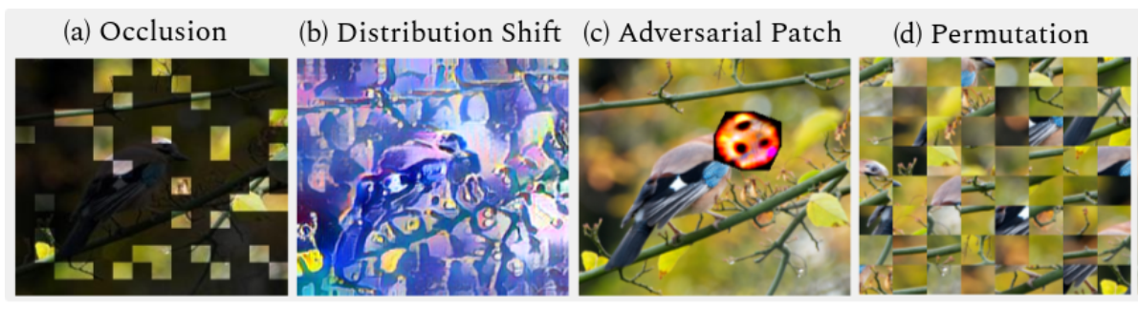
ViT
Use standard Transformer solely to do CV supervised classification without CNN. 224x224 to 16x16 patches as tokens in Transformer.
Interesting property of Transformer in CV.
Push the unification of CV and NLP.
Naseer, Muhammad Muzammal, et al. "Intriguing properties of vision transformers." Advances in Neural Information Processing Systems 34 (2021): 23296-23308.
Unified text-vision tasks/ multimodal tasks

Slide 35
Transformer in CV?
In large-scaled image recognition, CNNs are still the SOTA!
(ICLR 2020) do this 2x2 on cifar, while ViT’s story is training a large model!
CNN-like architectures with self-attention
Inputs(224x224) – CNN – feature maps –Self-attention (CVPR18 Non-local Network)
Replace the convolutions entirely
Use local window as input (Standalone Attention)
Attention on height dimension and width dimension separately, 2d – 1d + 1d (Axial Attention)

Slide 36
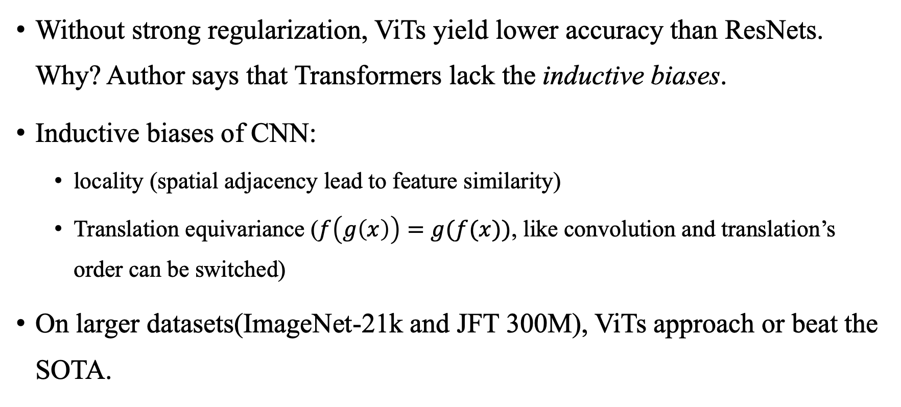
Performance on large scaled dataset?
Without strong regularization, ViTs yield lower accuracy than ResNets. Why? Author says that Transformers lack the inductive biases.
Inductive biases of CNN:
locality (spatial adjacency lead to feature similarity)
Translation equivariance ($f\left(g\left(x\right)\right)=g(f(x))$, like convolution and translation’s order can be switched)
On larger datasets(ImageNet-21k and JFT 300M), ViTs approach or beat the SOTA.

Slide 37
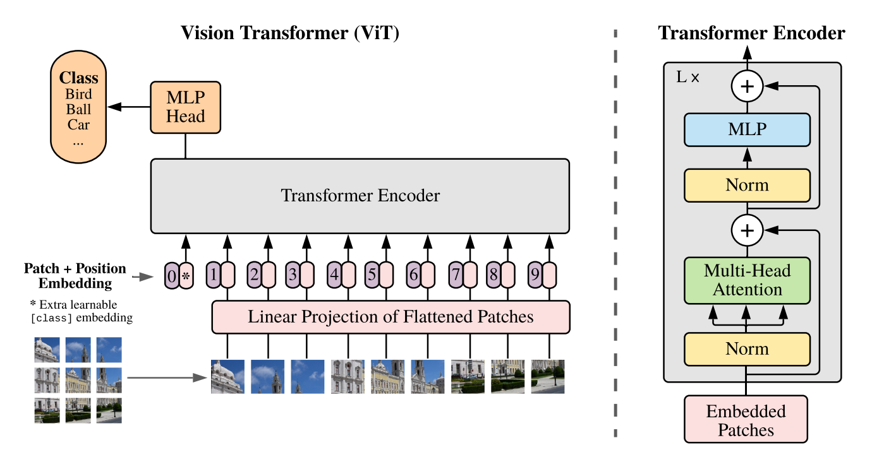
Architecture

Slide 38
Architecture
Linear Projection (E)
Just FC: size( (16x16x3)xD, 768x768 )
Position Embedding
1D learnable Position matrix (postionx768)
Just add, not concatenate
Extra learnable {class} embedding
1x768
Final Input(with multi-head N = 12)
197x768

Slide 39
Alternative way to do embedding
Named Hybrid Architecture
Formed from feature maps of CNN
224x224 – ResNet50 – 14x14 – 196
Still use Linear Projection (E)
Just FC: size( (16x16x2)xD, 768x768 )

Slide 40
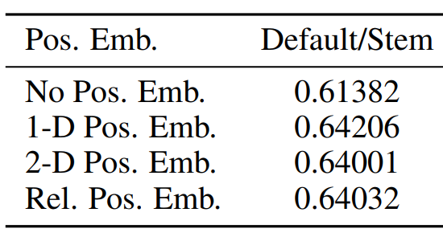
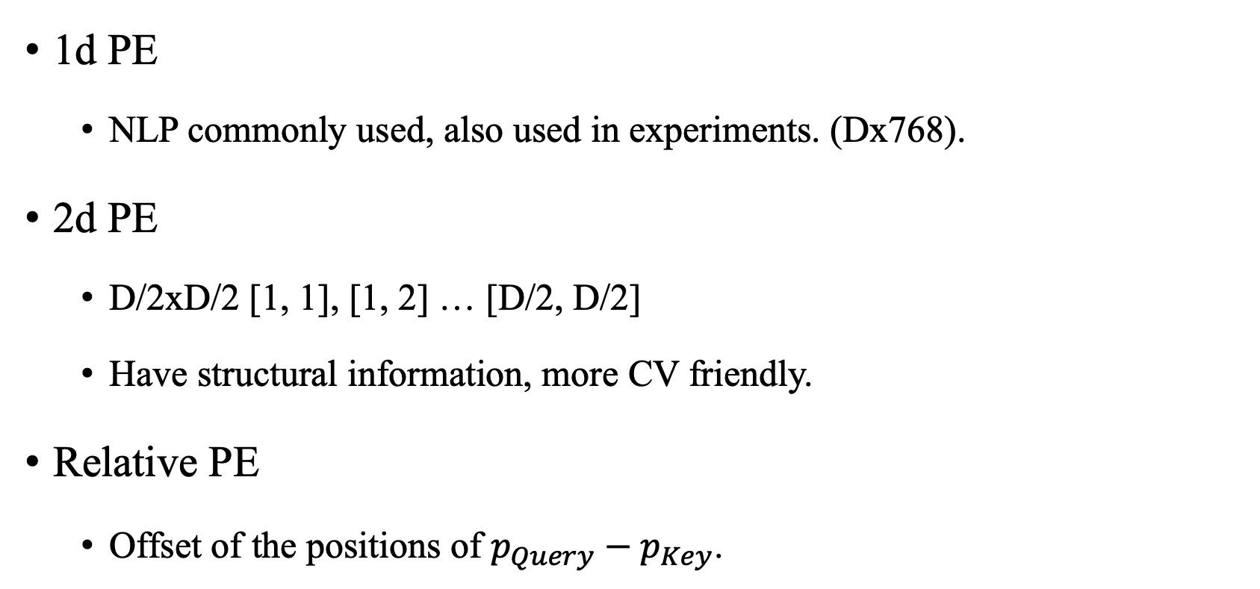
Positional embedding
1d PE
NLP commonly used, also used in experiments. (Dx768).
2d PE
D/2xD/2 [1, 1], [1, 2] … [D/2, D/2]
Have structural information, more CV friendly.
Relative PE
Offset of the positions of $p_{Query}−p_{Key}$.

Slide 41
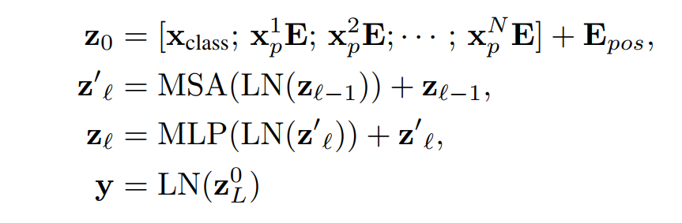
Architecture
Embedded Patches Input
197x64x12 (with multi-head N = 12)
Process
197x64x12 – Multi-head Attention
– 197x768 – Norm – 197x768 – MLP
– (197x768 – 197x3012 – 197x768)

Slide 42
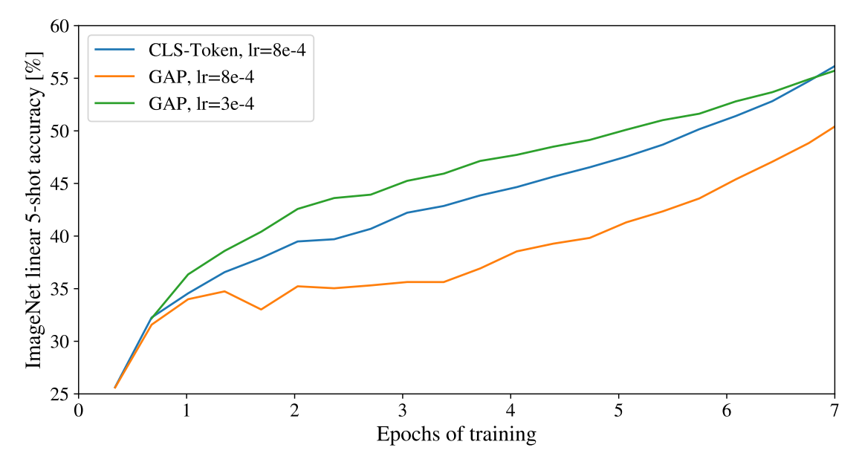
Architecture
Output
Why [cls] + MLP Head? Not globally average pooling(GAP) + linear classification like ResNet?
Both fine in experiments. But try to stay as close as possible to original Transformer.

Slide 43
Finetuning
Pretrain ViT on large datasets, then finetune to smaller downstream tasks.
If high-solution, sequence length grows. Position Embedding will be no longer meaningful.
Perform 2D interpolation of the pre-trained position embeddings can be useful.

Slide 44
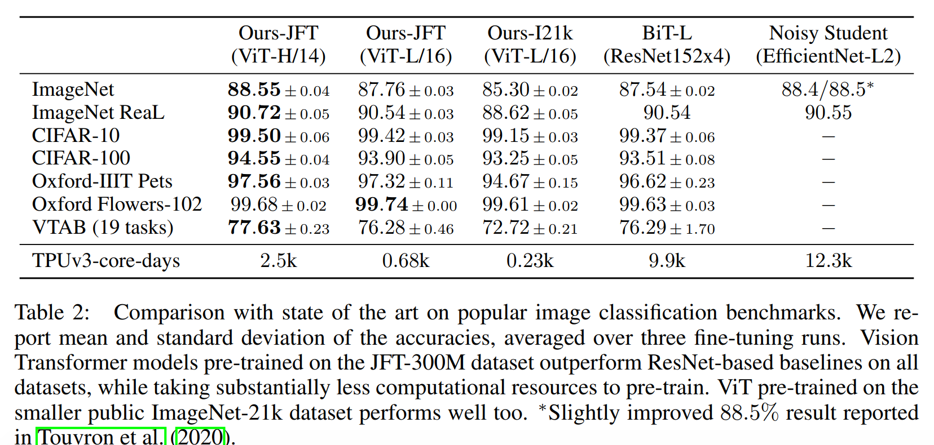
Experiments

Slide 45
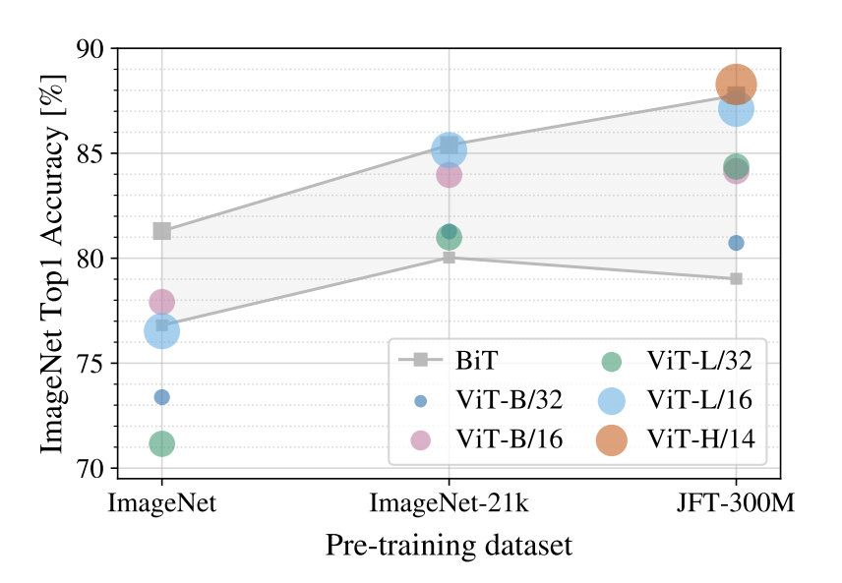
Experiments
ViTs apply some strong regularizations like dropout, wd.
Shaded areas are what BiTs performance.
When pretrained on smaller dataset like ImageNet, ViTs are beaten. While on JFT-300M, ViTs performs better.

Slide 46
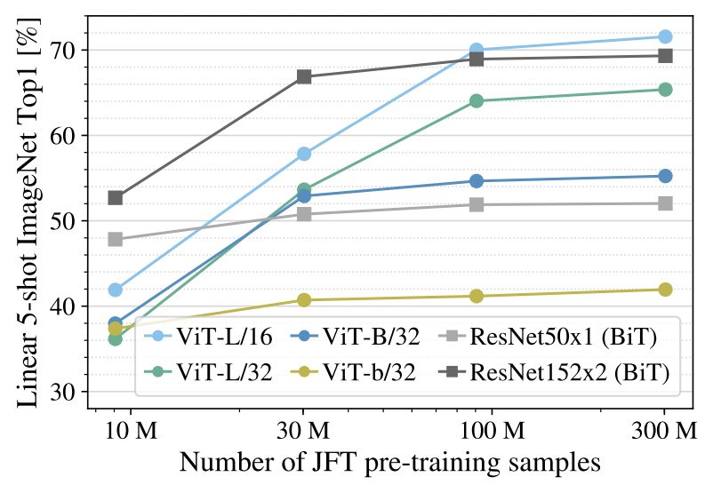
Experiments
Just do linear probing, freezing Transformer encoder.
5-shot evaluation (5 samples in every class).
Both from JFT, no distribution gap.
ViTs become stronger as dataset grows.

Slide 47
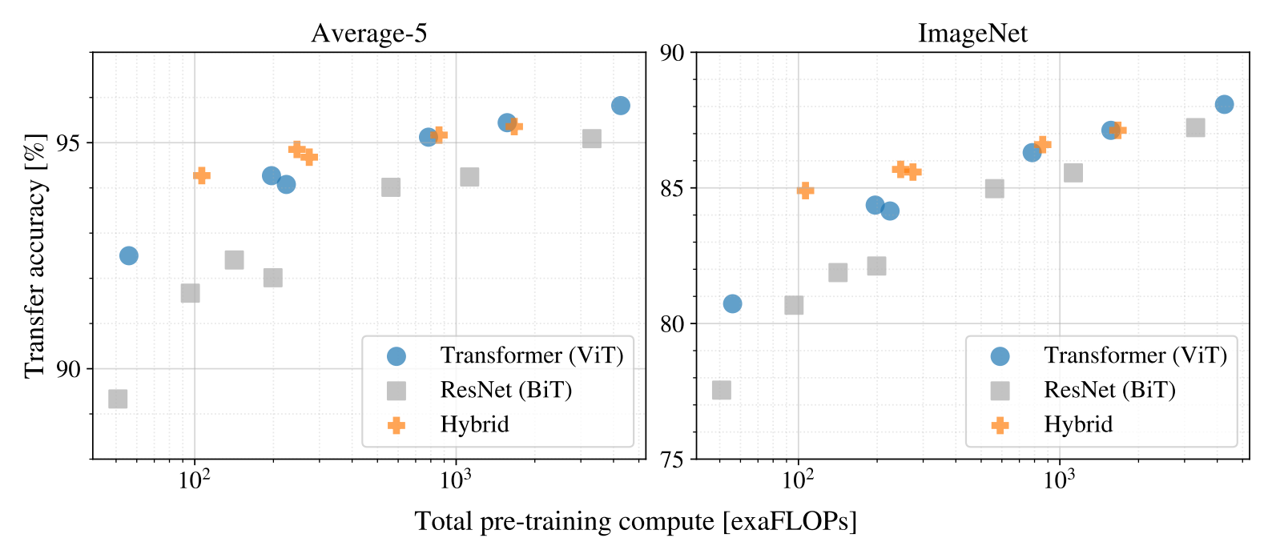
Experiments
Same computation complex, ViTs are better performed than ResNets.
On small dataset, hydrids are better, while acc not that good as dataset grows, means that CNN don’t help ViT to learn better when dataset is large.

Slide 48
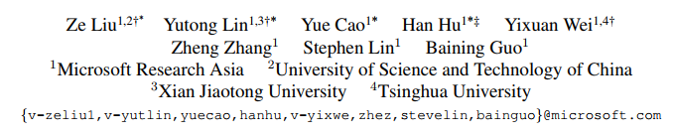
Swin Transformer: Hierarchical Vision Transformer using Shifted Windows
ICCV 2021 Best Paper

Slide 50

Masked Autoencoders Are Scalable Vision Learners

Slide 51
MAE is like a Bert in CV version!
 | NLP | CV
Self Supervised | BERT | MAE
Supervised | Transformer | ViT
While ViT authors already introduced cloze task to train ViT in a self-supervised manner, what’s the difference?

Slide 52
What makes difference between vision and language in autoencoder tasks?
Architectures were different. While now ViT use Transformer in Vision.
Information density.
Languages are highly semantic and information-dense.
Images are with heavy spatial redundancy. A missing patch is easily been recovered using interpolation.
Decoder
Bert encoder can be trivial(MLP), for predicting missing words is in fact a recognition task.
Vision recovering is harder. MLP is not enough.

Slide 53
Masked Autoencoder (MAE)
Mask random patches of the input image and reconstruct the missing pixels.
Masking a high proportion of the input image, e.g., 75%, yield a non-trivial and meaningful self-supervisory task.
Vanilla ViT-Huge models achieves 87.8% that use only ImageNet-1k by MAE tasks, compared to ViT-Huge models 85.13% that use ImageNet-21k .
Outstanding transferability.

Slide 54

Architecture
Mask (drop) 75% patches and straighten. After encoded, recover the reps with shared learnable patch.
Encoder is larger than decoder, and decoder would
be dropped in downstream tasks.
Encoder & decoder are ViT.
Decoder’s input is full set of
encoded visible patches and mask tokens.

Slide 55
Architecture
MAE constructs the input by predicting the pixel values for each patches, e.g. 256 – 16x16.
Loss function is MSE in the pixel space.
Simple implement:
Generate token (by linear projection
add positional embeddings).
Randomly shuffle the list and remove.
Encode, append mask tokens and unshuffled
Decode the full list (with positional embeddings).

Slide 56

Experiments
On ImageNet-1k, use ViT-L/16 as backbone.
ViT-L is very big and can overfit and not stable (76.5%). So authors add strong regularization (82.5%).
MAE achieves 84.9%.

Slide 57


Experiments
Self-supervised methods comparison.
Evaluated by end-to-end fine-tuning.
Compared with supervised pre-training.
JFT-300M is not that similar with ImageNet.

Slide 58

Ablation studies
Encoder without mask tokens is better.
Simple pixel reconstruction is enough.
MAE is not sensitive to data augmentations.
Random sampling is better.

Slide 59


Ablation studies
Masking Ratio = 70 – 80 woks well both in fine-tuning and linear probing.
Tuning 0 blocks is linear probing; 24 is full fine-tuning. MAE learns more general shallow layer representations so there is no need to fine-tune in down stream tasks.

Slide 60


Transfer Learning Experiments
Objection and Segmentation on COCO
Semantic Segmentation on ADE20K

Slide 61

Momentum Contrast for Unsupervised Visual Representation Learning
MoCo CVPR2020 Best Paper

Slide 62
Contrastive Learning
Kind of Self-supervised Method.
Positive pairs are close, while negative pairs away from each other.
A mainstream proxy/pretext task: Instance Discrimination.
Using Augmentation to decide positive or negative pairs.
Flexible. Standard pipeline, only need to decide what is positive or negative pairs
E.g. SimCSE: double forward with dropout to build positive pairs.
E.g. CMC: different views as positive pairs, like front and back, RGB and depth images.

Slide 63
MoCo: Why Momentum Contrast?
MoCo views contrastive learning as dictionary look-up, Anchor as query, positive/negative as key. MoCo hypothesizes that dictionary should be
Large: if small, model can learn a short-cut solution, against generalization.
Consistent: keys should be generated by the same of similar encoders.
with a dynamic dictionary with a queue and a moving-averaged encoder, to build a large and consistent dictionary on the fly.
MoCo outperforms its supervised pre-training counterpart in 7 tasks.

Slide 64

MoCo: Why Momentum Contrast?
All samples in memorybank, use encoder to update features
SimCLR: Not large enough
MemoryBank: Not consistent
MoCo: Large and consistent
Use momentum updates on reps
Use momentum updates on encoder

Slide 65


MoCo
MoCo uses queue to decouple dictionary size from batch size, so that dictionary size can be very large.
MoCo uses a momentum encoder to make sure that key representations are consistent.
MoCo uses Instance Discrimination to do pretraining. Others tasks are fine as well.

Slide 66


InfoNCE loss
Assume that there is a single key, K here is dictionary size, rather than class number.
Noise contrastive estimation (NCE):
Noise: Binary classification (sample or noise).
Estimation: sample some negatives to compute loss.
InfoNCE：(K+1)-way multi-classification, where $τ$ is temperature. $τ$ is larger, distribution is smoother.

Slide 67

MoCo
N = 256, C = 128
K = 65536 (dict size)
Every ground truth
is on the 0 position
Momentum on f_k

Slide 68



Experiments
Performance starts to saturate from 16384 - 65536

Slide 69



Transferring Features
Slightly underperformed
On several tasks, cityscapes
instance segmentation and
VOC semantic segmentation.
Dense prediction task (pixel)

Slide 70
InstDist, CPC, CMC

Slide 71
MoCo v1, MoCo v2, SimCLR v1, SimCLR v2, SwAV

Slide 72
BYOL, SimSiam

Slide 73
MoCo v3, DINO

Slide 74
Theoretically Principled Trade-off between Robustness and Accuracy TRADES, ICML 2019
Adversarial training
Cited by 1247

Slide 75
Adversarial training
Reveal the theoretical basis of the trade-off between robustness and accuracy.
Decompose robust error as the sum of nature classification error and boundary error.
Provide a differential upper bound.
Propose a new defense method TRADES
Conduct sufficient experiments on real-world dataset
Theoretical Analysis
Novel method
Experiments

Slide 76



Theoretical analysis (on binary classification)
Representation:
X, Y: random variables
x, y: realization of r.v.
x: sample instance
y: {-1, +1} label
sign(x): sign(0)=+1
f: score function
sign(f(-)): classifier
1{event} or φ(-): 0-1 loss
||x||: a generic norm
DB(f): decision boundary of f
B(x, ε): neighborhood of x
﻿Robust (classification) error
Definition: samples that have wrong-classified neighbors
﻿Nature (classification) error
﻿Boundary error
Definition: samples that around decision boundary and correct-classified
﻿decomposition

Slide 77

Theoretical analysis (on binary classification)
﻿decomposition
R_{rob} = (G + B + F) + (C + F)
A and D are correct, not contribute to loss

Slide 78



Theoretical analysis (on binary classification)
0-1 loss is hard to optimize, we need a tight differentiable upper bound
We call the tractable surrogate loss φ, and it is classification-calibrated
﻿the theory of classification-calibrated loss
We can find how much error the estimation of this upper bound is with the original function, and this property will be used later to prove that approximation is tight
The upper bound can be derived by the inequality

Slide 79





Theoretical analysis (on binary classification)
﻿Upper bound
﻿Lower bound

Slide 80

Algorithmic Design
Second term to minimize the difference between clean sample and adversarial sample.
Max(φ(-)) to generate adversaries
First term to improve accuracy, same as common loss function.

Slide 81


Algorithmic Design
A toy model
It shows that both methods achieve zero natural training error, while TRADES achieves better robust training error than the natural training method
﻿natural training method
﻿learned by TRADES

Slide 82


Experiments

Slide 83

Experiments

